Slide 1






Overall
Vehicle Type
Revenue
Cancellation
Ratings

Slide 2







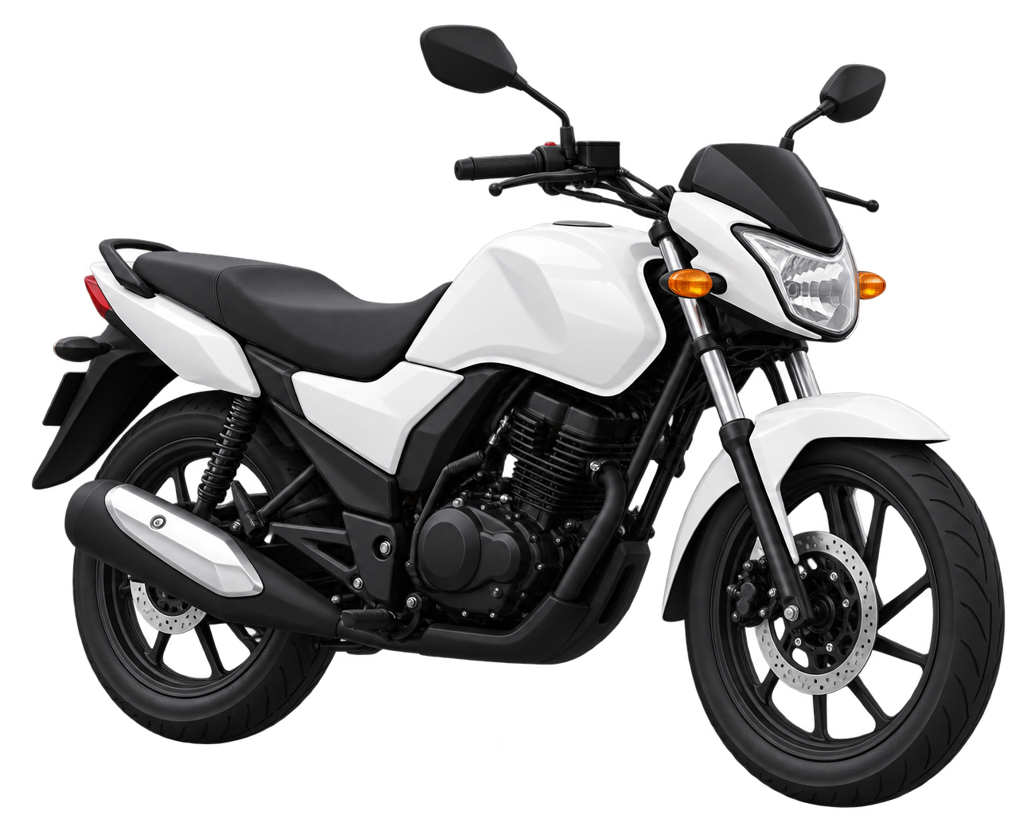
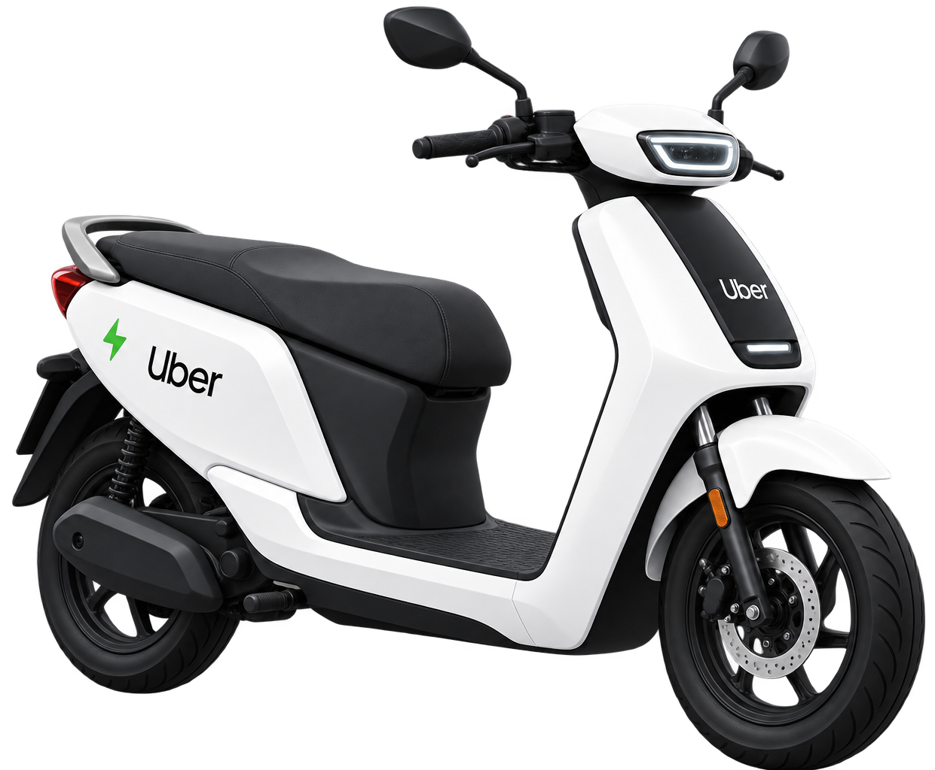
All Vehicle Types | Total Booking Value | Successful Booking Value | Avg. Distance Travelled | Total Distance Travelled
Overall
Prime Sedan
Vehicle Type
Prime SUV
Prime Plus
Revenue
Mini
Cancellation
Auto Rickshaw
Ratings
Bike
E-Bike

Slide 3

Overall
Vehicle Type
Revenue
Cancellation
Ratings

Slide 4

Overall
Vehicle Type
Revenue
Cancellation
Ratings

Slide 5

Overall
Prime Sedan
Prime SUV
Prime Plus
Mini
Auto Rickshaw
Bike
E-Bike
Vehicle Type
Revenue
Cancellation
Prime Sedan
Prime SUV
Prime Plus
Mini
Auto Rickshaw
Bike
E-Bike
Ratings

